Slide 1
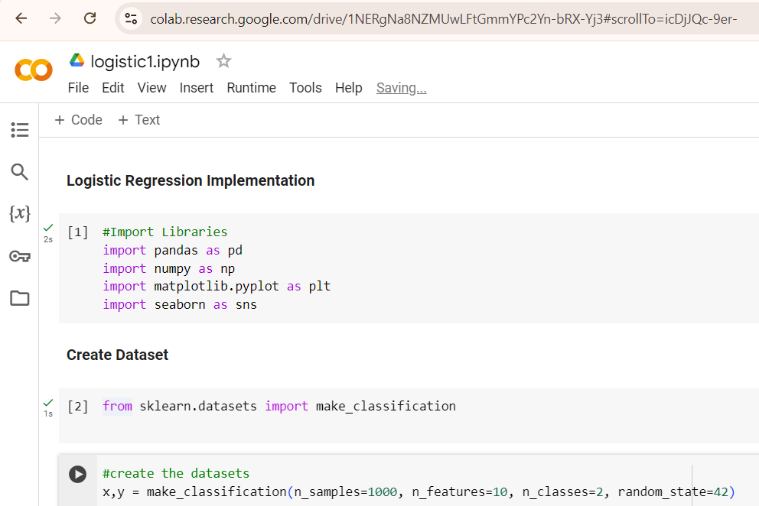
To generate a random classification dataset for binary or multiclass classification problems

Slide 2
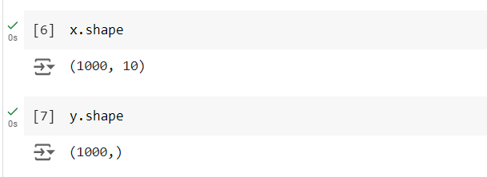
.shape It tells you the number of rows and columns in a n-Dimensional array
x is a 2D array (matrix) with 1000 rows and 10 columns
y array contains 1000 labels, corresponding to the 1000 samples in x.

Slide 3
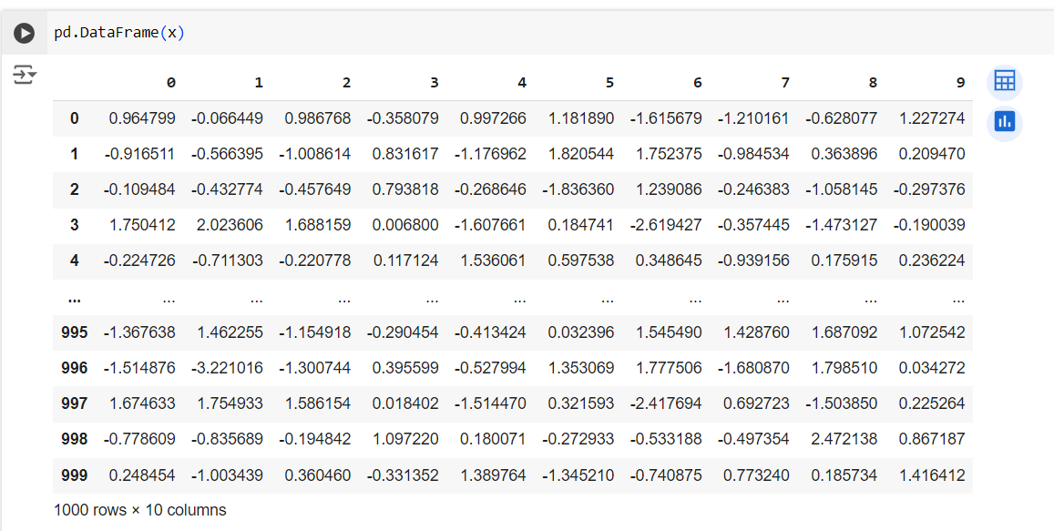
DataFrame(x): This function converts the array x into a pandas DataFrame

Slide 4
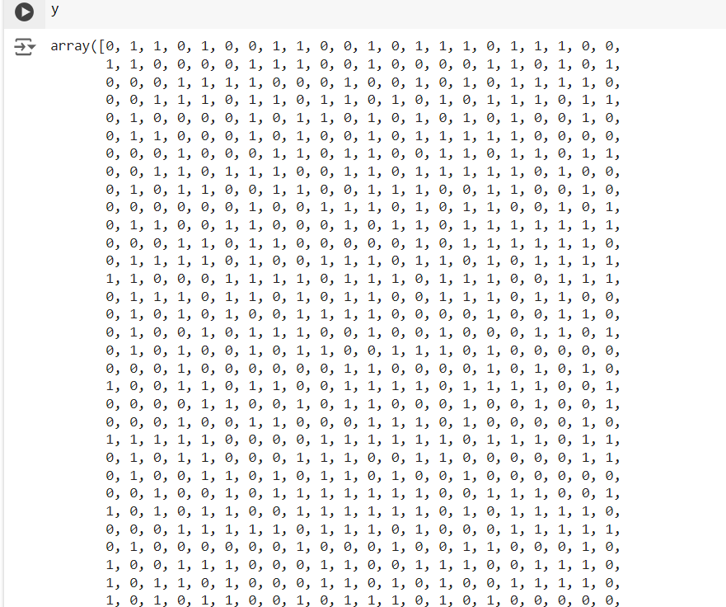
y array contains 1000 labels, corresponding to the 1000 samples in x. For Binary classification

Slide 5
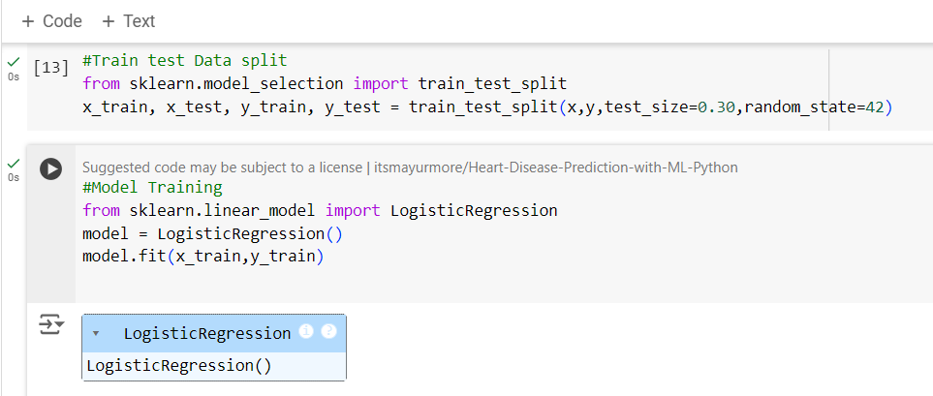

Slide 6
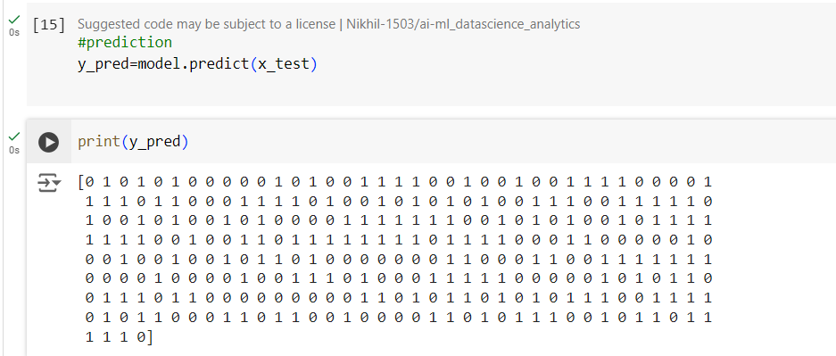
Predict the test data (x_test)
Print the predicted labels (y_pred)

Slide 7
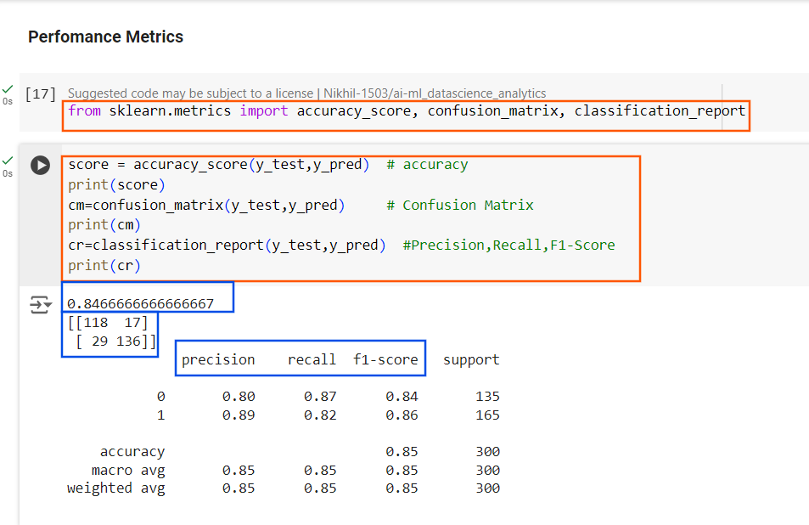

Slide 8
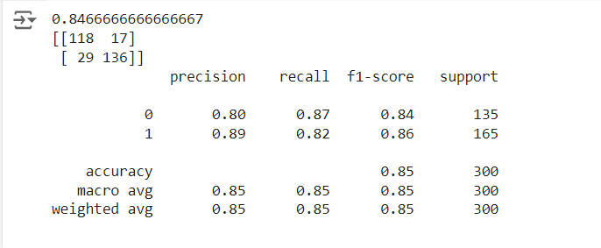
Precision: For class 0, 80% of the predicted 0's were actually 0's, and for class 1, 89% of the predicted 1's were actually 1's.
Precision measures the accuracy of the positive predictions.
Recall measures the model's ability to detect positive samples.
Recall: The model correctly identified 87% of the true class 0's, and 82% of the true class 1's.
F1-Score: The balance between precision and recall for each class (0.84 for class 0, 0.86 for class 1).
Support: Indicates that there are 135 samples of class 0 and 165 samples of class 1 in y_test.
Macro Avg: The average of the precision, recall, and F1-score across all classes, treating all classes equally. This means smaller classes get the same importance as larger classes.
Weighted Avg: A weighted average of precision, recall, and F1-score, considering the support (i.e., the number of true instances for each class). Larger classes will have a greater impact on the weighted average.

